Slide 1
Remote Sensing for Urban Planning

Slide 2
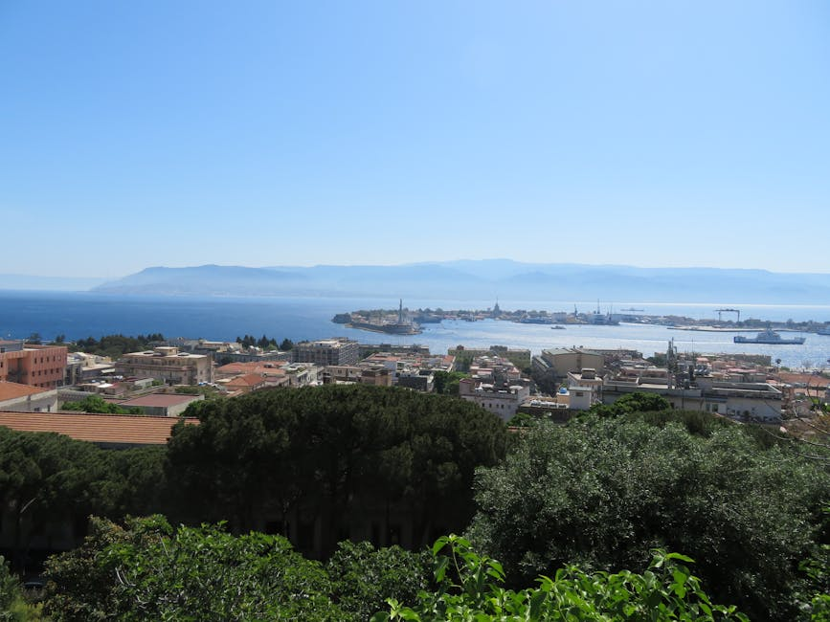
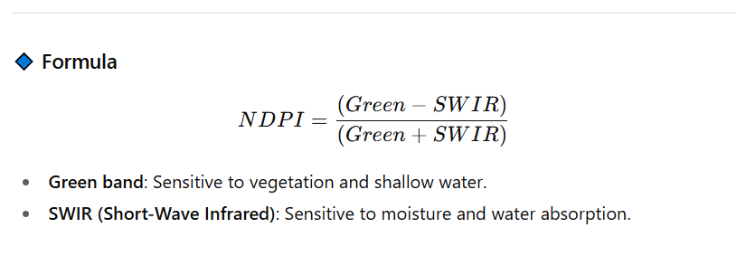
Urban Growth Monitoring
racks land use/land cover changes and urban sprawl
using satellite imagery.

Slide 3
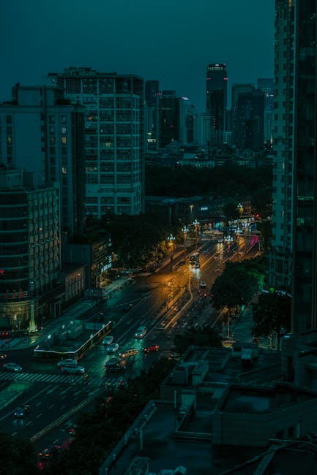
Infrastructure Planning
Supports road, transport, utility, and smart
city development with high-resolution data.

Slide 4

Environmental Management
Assesses urban heat islands, pollution,
and green space availability.

Slide 5

Disaster Management
Provides flood risk maps, earthquake
damage assessment, and fire hazard monitoring.

Slide 6
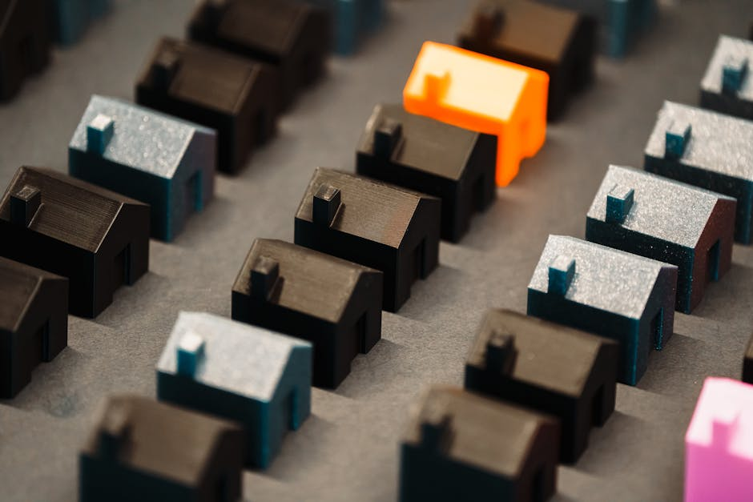
Smart Cities & 3D Modeling
Uses LiDAR and high-res imagery for 3D urban models
and smart infrastructure design.

Slide 7
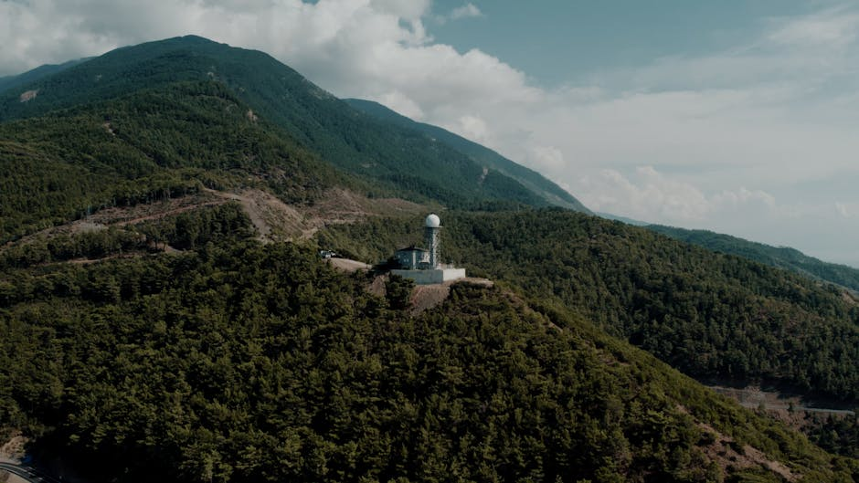
Data Sources
Optical (Landsat, Sentinel-2), Radar (Sentinel-1),
LiDAR, and Thermal (MODIS, Landsat TIRS).

Slide 8
Discussion
Questions?
Thank You

